Slide 1
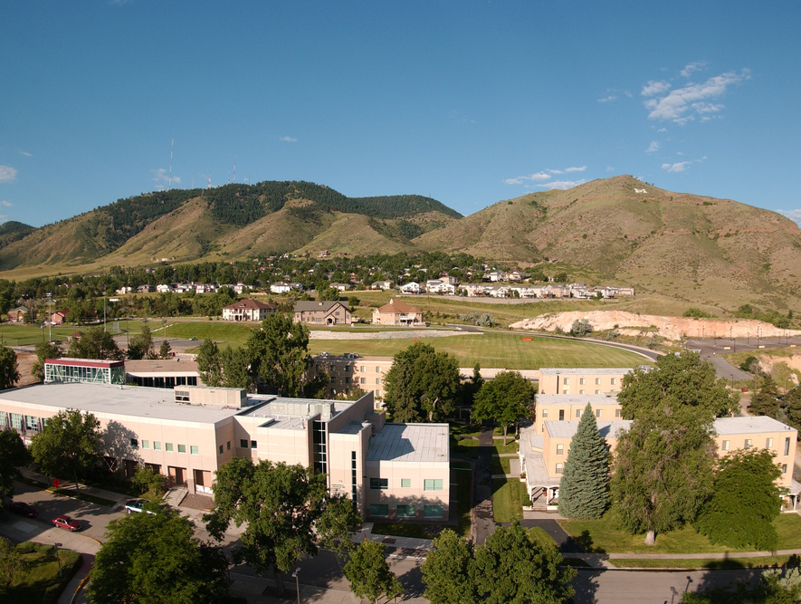
Colorado School of Mines
Computer Vision
Professor William Hoff
Dept of Computer Science
http://inside.mines.edu/~whoff/

Slide 2
Alignment using Nonlinear Least Squares

Slide 3
Recall 2D Rigid Transformation
A 2D rigid transform (rotation + translation) is
Since we treated c = cos θ and s = sin θ as independent variables, we got a system of linear equations
But c,s are not independent – we should really just solve for 3 variables (tx,ty, θ), not 4 variables … this gives us a system of non linear equations
We can still solve for the unknowns using least squares, but it requires an iterative algorithm

Slide 4
Newton’s Method
f(x)
y
Example for a scalar function
Given
A known function y = f(x)
A value of y, call it y₁
Find x₁ such that y₁ = f(x₁)
y₁
x₁?
x

Slide 5
Newton’s Method
f(x)
y
Example for a scalar function
Given
A known function y = f(x)
A value of y, call it y₁
Find x₁ such that y₁ = f(x₁)
Strategy
Make a starting guess for x, call it x₀
If this were correct, y would be y₀ = f(x₀)
So the error is Δy = y₁ – y₀
What does this say about x?
It depends on the relationship between y and x. Because this is non-linear we can’t get at it directly, but we can estimate it if we assume f(x) is locally linear
We know Δy = df/dx Δx … so Δx = Δy / (df/dx)
Set x₀ = x₀ - Δx
And repeat until convergence!
y₁
y₀
x₀
x₁?
x
df/dx is the slope of f(x), evaluated at x₀

Slide 6

Vector Functions
This was for a scalar function
How will we accomplish this when x and y are vectors?
$$y=f(x)$$
vector
vector function
vector

Slide 7
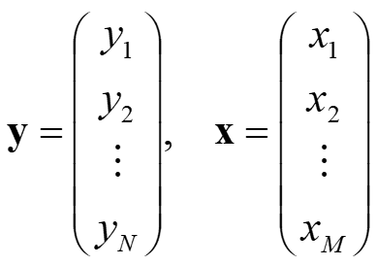
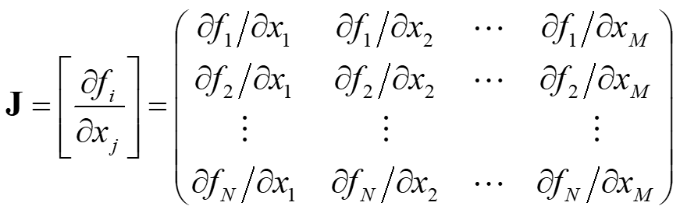
Nonlinear Least Squares
We have a nonlinear function y = f(x)
x is a vector of our unknowns
y is a vector of our observations
We start with a guess for x, call it x0
We linearize (take the Taylor series expansion) about that point
dy = [∂f/ ∂x]_{x0} dx (ignoring all higher order terms)
The matrix of partial derivatives of f with respect to x is called the Jacobian matrix

Slide 8
Nonlinear Iterative Least Squares Algorithm
We have
y0 = observations or measurements
x0 = a guess for x
y = f(x) is a non linear function
Initialize x to x0
Compute y = f(x). Residual error is dy = y-y0
Calculate Jacobian of f, evaluate it at x. We now have dy = J dx
Solve for dx using pseudo inverse dx = (J^{T}J)⁻¹J^{T} dy
Set x <= x - dx
Repeat steps 2-5 until convergence (no more change in x)

Slide 9
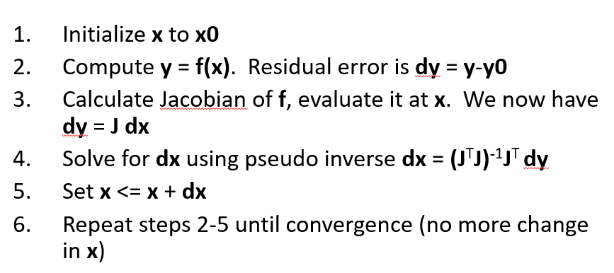
How do you calculate the Jacobian?
Let’s see how it works with 2D rigid transformations!

Slide 10

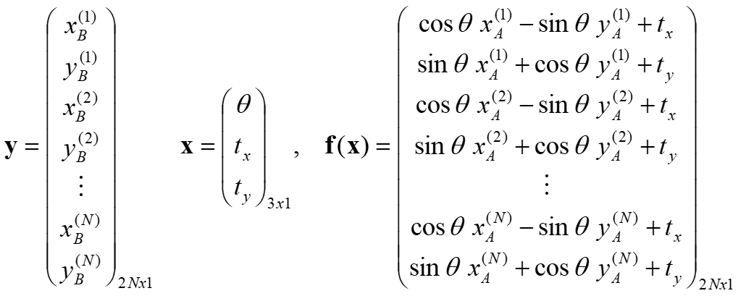
Example – 2D rigid transformation
Recall
We have N corresponding points
Let y = f(x), where

Slide 11
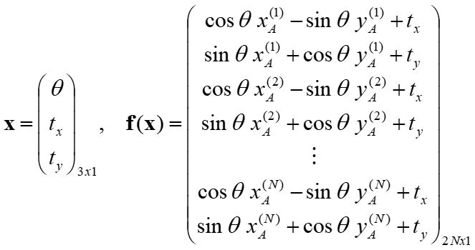
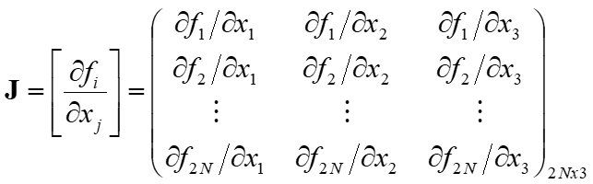
Example
Jacobian?

Slide 12
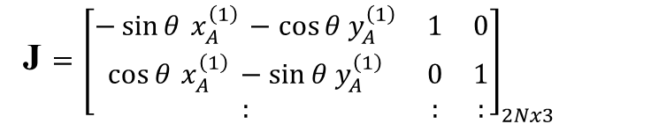
Example
Jacobian?
$$\frac{∂f_{1}}{∂x_{1}}=\frac{∂}{∂θ}\left(\cos{θ} x_{A}^{(1)}−\sin{θ} y_{A}^{\left(1\right)}+t_{x}\right)=−\sin{θ}{ x}_{A}^{\left(1\right)} −\cos{θ}{ y}_{A}^{\left(1\right)}$$
$$\frac{∂f_{1}}{∂x_{2}}=\frac{∂}{∂t_{x}}\left(\cos{θ} x_{A}^{(1)}−\sin{θ} y_{A}^{\left(1\right)}+t_{x}\right)=1, \frac{∂f_{1}}{∂x_{3}}=\frac{∂}{∂t_{y}}\left(\cos{θ} x_{A}^{(1)}−\sin{θ} y_{A}^{\left(1\right)}+t_{x}\right)=0$$
J $={\left[\begin{matrix}−\sin{θ}{ x}_{A}^{\left(1\right)} −\cos{θ}{ y}_{A}^{\left(1\right)} & 1 & 0 \\ \cos{θ}{ x}_{A}^{\left(1\right)} −\sin{θ}{ y}_{A}^{\left(1\right)} & 0 & 1 \\ : & : & :\end{matrix}\right]}_{2Nx3}$

Slide 13
Python code to create Jacobian
Assume that pA contains points from image A
Each column is the coordinates of a point, in the form (x,y,1)
There are N points, so pA has N columns
Let (theta, tx, ty) be the current estimates for the unknown parameters
# Create the Jacobian.
J = np.zeros((2 * N, 3)) # N is the number of points
theta = x[0]
for i in range(N): # Fill in values of J
J[2 * i, :] = np.array(
(-np.sin(theta) * pA[0, i] - np.cos(theta) * pA[1, i], 1, 0))
J[2 * i + 1, :] = np.array(
(np.cos(theta) * pA[0, i] - np.sin(theta) * pA[1, i], 0, 1))

Slide 14
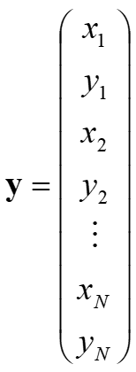
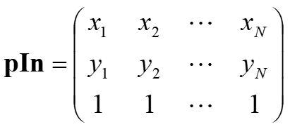
Python code for the function f(x)
This function does a 2D rigid transform on a set of points
x = [theta, tx, ty] is the vector of parameters
pIn is the set of input points
y is the vector of output points
# Do a 2D rigid transform on a set of points.
def fRigid(x, pIn):
assert pIn.shape[0] == 3 # Each column is (x,y,1)
N = pIn.shape[1] # Number of points
theta, tx, ty = x # Extract parameters from parameter list
H = np.array([[np.cos(theta), -np.sin(theta), tx],
[np.sin(theta), np.cos(theta), ty],
[0, 0, 1]])
pOut = H @ pIn # 3xN matrix
# Return pOut as a vector with values [x1,y1,x2,y2,x3,y3 ...]
return np.reshape(pOut[0:2,:], 2*N, order='F')

Slide 15
Python code to solve for parameters
# Iterate until the solution converges.
while True:
print("Parameters (theta; tx; ty): (%f, %f, %f)" % (x[0], x[1], x[2]))
y = fRigid(x, pA) # Call function to compute expected measurements
dy = y - y0 # new residual
# Create the Jacobian for this iteration.
J = np.zeros((2 * N, 3)) # N is the number of points
theta = x[0]
for i in range(N): # Fill in values of J
J[2 * i, :] = np.array(
(-np.sin(theta) * pA[0, i] - np.cos(theta) * pA[1, i], 1, 0))
J[2 * i + 1, :] = np.array(
(np.cos(theta) * pA[0, i] - np.sin(theta) * pA[1, i], 0, 1))
dx = np.linalg.pinv(J) @ dy
# Stop if parameters are no longer changing.
if np.linalg.norm(dx) < 1e-6:
break
x = x - dx # add correction

Slide 16
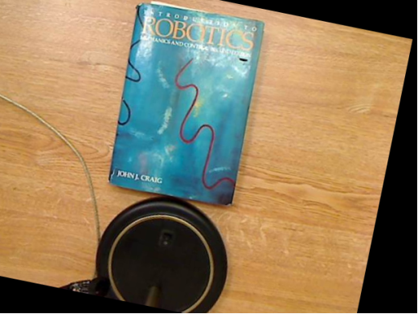
Apply final transform to image
# Apply transform to image A.
theta = x[0]
tx = x[1]
ty = x[2]
A = np.array([[np.cos(theta), -np.sin(theta), tx],
[np.sin(theta), np.cos(theta), ty]])
img_transformed = cv2.warpAffine(imgA, A, (imgA.shape[1], imgA.shape[0]))
cv2.imshow("Transformed image A", img_transformed)

Slide 17
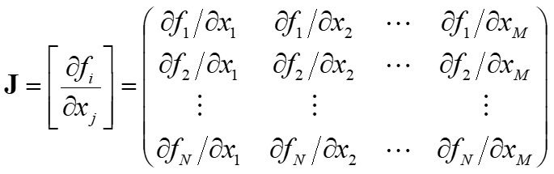
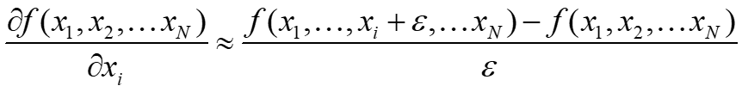
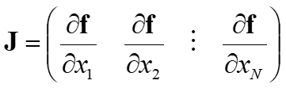
Computing Jacobian Numerically
An alternative way to compute the Jacobian matrix
It’s easier, but more computation
Recall definition of derivative
Python code:
Column vectors
# Estimate J numerically.
e = 1e-6 # A tiny number
J[:,0] = (fRigid(x + [e,0,0], pA) - y) / e
J[:,1] = (fRigid(x + [0,e,0], pA) - y) / e
J[:,2] = (fRigid(x + [0,0,e], pA) - y) / e

Slide 18
Complete Python code to solve for 2D rigid transform (uses numerically estimated Jacobian)
def main(): # Specify corresponding points. Each point is (x,y,1). pA = np.array([[212,28,1], [397,19,1], [400,292,1], [222,296,1]]) pB = np.array([[206,6,1], [390,33,1], [338,301,1], [163,269,1]]) N = pA.shape[0] # Number of points # Get each point set as a 3xN matrix (ie, each column is x,y,1). pA = pA.T pB = pB.T # Get pB as a vector with values [x1,y1,x2,y2,x3,y3 ...] y0 = np.reshape(pB[0:2,:], 2*N, order='F') # y0 is a vector of size (2N,) # Create an initial guess for parameters to be solved for. theta = 0 tx = 0 ty = 0 x = np.array([theta, tx, ty]) # Put parameters into a vector # Iterate until the solution converges. while True: print("Parameters (theta; tx; ty): (%f, %f, %f)" % (x[0], x[1], x[2])) y = fRigid(x, pA) # Call function to compute expected measurements dy = y - y0 # new residual # Create the Jacobian for this iteration. J = np.zeros((2 * N, 3)) # N is the number of points theta = x[0] for i in range(N): # Fill in values of J J[2 * i, :] = np.array( (-np.sin(theta) * pA[0, i] - np.cos(theta) * pA[1, i], 1, 0)) J[2 * i + 1, :] = np.array( (np.cos(theta) * pA[0, i] - np.sin(theta) * pA[1, i], 0, 1)) # Estimate J numerically. e = 1e-6 # A tiny number J[:,0] = (fRigid(x + [e,0,0], pA) - y) / e J[:,1] = (fRigid(x + [0,e,0], pA) - y) / e J[:,2] = (fRigid(x + [0,0,e], pA) - y) / e dx = np.linalg.pinv(J) @ dy # Stop if parameters are no longer changing. if np.linalg.norm(dx) < 1e-6: break x = x - dx # add correction
Output:
Parameters (theta; tx; ty): (0.000000, 0.000000, 0.000000)
Parameters (theta; tx; ty): (0.198634, -1.966835, -67.629573)
Parameters (theta; tx; ty): (0.200299, 4.237758, -64.557164)
Parameters (theta; tx; ty): (0.200302, 4.238734, -64.557614)
Parameters (theta; tx; ty): (0.200302, 4.238735, -64.557615)

Slide 19
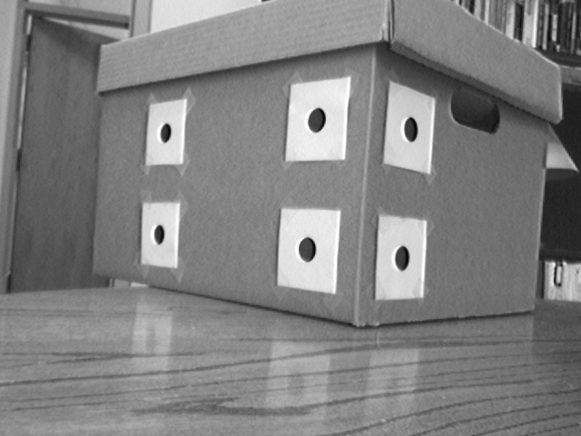
Model-based Pose Estimation
Problem Statement
Given
We have an image of an object (or model)
We know the location of features on the model
We have the corresponding features in the image
Find
The position and orientation (pose) of the object with respect to the camera
Assumptions
Object is rigid (so only 6 degrees of freedom)
Camera intrinsic parameters are known
We will find the pose that minimizes the squared error of the predicted locations of the image features, to the measured locations
# points needed?
{M}

Slide 20
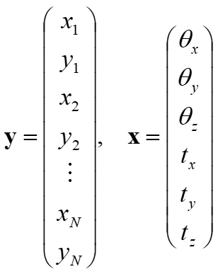
Least Squares Pose Estimation
Let y = f(x)
x is a vector of the unknown pose parameters
f is a function that returns the predicted image points y, given the pose x
y0 is a vector of the actual observed image points
The function f is just perspective projection
For one point, this is
We need to do this for all points

Slide 21
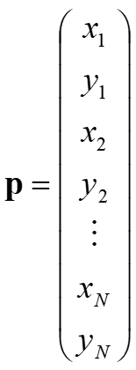
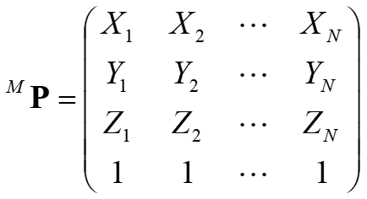
Python code for the function f(x)
This function does a 2D rigid transform on a set of points
P_M = is a set of input points
x = [ax,ay,az,tx,ty,tz] is the pose
K = intrinsic camera matrix
p = [x1,y1,x2,y2, …] are the output points
# Project a set of 3D points onto image. def fProject(x, P_M, K): ax, ay, az, tx, ty, tz = x # Extract parameters from parameter list # Rotation matrix, model to camera R = xyz_angles_to_rot(ax,ay,az) # (you do this!) # Extrinsic camera matrix trans = np.array([[tx, ty, tz]]).T Mext = np.block([R, trans]) p = K @ Mext @ P_M # Project points # Divide by 3rd element of each column p = p / p[2,] # Return image points as a vector: (x1,y1,x2,y2,x3,y3, ...) return np.reshape(p[:2,], -1, 'F')

Slide 22
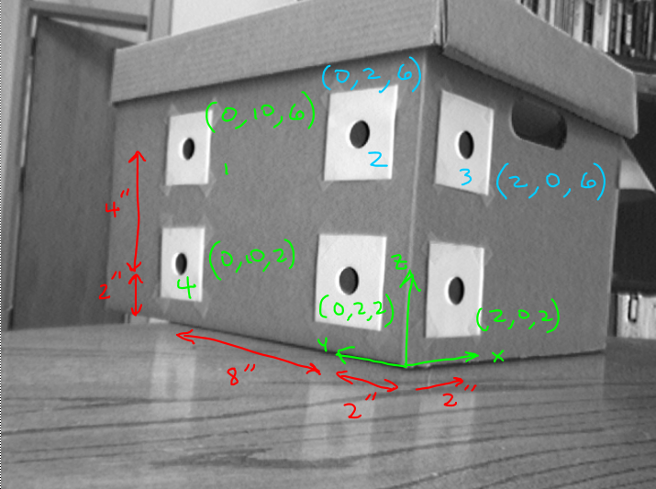
Example
Focal length in pixels: 715
Image center (x,y): (354, 245)

Slide 23
Example
# These are the points in the model's coordinate system (inches)
P_M = np.array([
[0, 0, 2, 0, 0, 2], # Each column is (x,y,z,1)
[10, 2, 0, 10, 2, 0],
[6, 6, 6, 2, 2, 2],
[1, 1, 1, 1, 1, 1]])
N = P_M.shape[1] # Number of points
# Define camera parameters
f = 715 # focal length in pixels
cx = 354
cy = 245
# You do this: create camera parameter matrix K
# Manually choose corresponding image points
pts = np.array([
[183, 147], # 1
[350, 133], # 2
[454, 144], # 3
[176, 258], # 4
[339, 275], # 5
[444, 286]]) # 6
# Optionally show points on the image, to verify locations.
# Get pts as a vector with values [x1,y1,x2,y2,x3,y3 ...]
y0 = np.reshape(pts, 2*N) # y0 is a vector of size (2N,)
# Make an initial guess of the pose [ax ay az tx ty tz].
# Angles ax,ay,az are in radians.
x = np.array([1.5, -1.0, 0.0, 0, 0, 30])
# Project current pose estimate to image points using fproject
y = fProject(x, P_M, K)

Slide 24
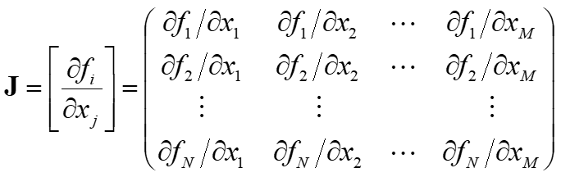
Computing Jacobian Numerically
We approximate the derivatives
Python code:
y = fProject(x, P_M, K)
# Create the Jacobian for this iteration.
J = np.zeros((2 * N, 6)) # N is the number of points
# Estimate Jacobian numerically.
e = 1e-6 # a tiny number
J[:,0] = ( fProject(x+[e,0,0,0,0,0],P_M,K) - y )/e
J[:,1] = ( fProject(x+[0,e,0,0,0,0],P_M,K) - y )/e
J[:,2] = ( fProject(x+[0,0,e,0,0,0],P_M,K) - y )/e
J[:,3] = ( fProject(x+[0,0,0,e,0,0],P_M,K) - y )/e
J[:,4] = ( fProject(x+[0,0,0,0,e,0],P_M,K) - y )/e
J[:,5] = ( fProject(x+[0,0,0,0,0,e],P_M,K) - y )/e

Slide 25
Python code to solve for pose (uses the numerically estimated Jacobian)
for i in range(10): print('\nIteration %d' % i) print(' Current pose:', x) # Project current pose estimate to image points using fProject. y = fProject(x, P_M, K) # Optionally visualize new estimated image points on image (if you want). # Create the Jacobian for this iteration. J = np.zeros((2 * N, 6)) # N is the number of points # Estimate Jacobian numerically. e = 1e-6 # a tiny number J[:,0] = ( fProject(x+[e,0,0,0,0,0],P_M,K) - y )/e J[:,1] = ( fProject(x+[0,e,0,0,0,0],P_M,K) - y )/e J[:,2] = ( fProject(x+[0,0,e,0,0,0],P_M,K) - y )/e J[:,3] = ( fProject(x+[0,0,0,e,0,0],P_M,K) - y )/e J[:,4] = ( fProject(x+[0,0,0,0,e,0],P_M,K) - y )/e J[:,5] = ( fProject(x+[0,0,0,0,0,e],P_M,K) - y )/e # Error is observed image points - predicted image points dy = y - y0 print(' Residual error: ', np.linalg.norm(dy)) # Ok, now we have a system of linear equations dy = J dx # Solve for dx using the pseudo inverse dx = np.linalg.pinv(J) @ dy # Stop if parameters are no longer changing if np.linalg.norm(dx) < 1e-6: break x = x - dx # Update pose estimate

Slide 26
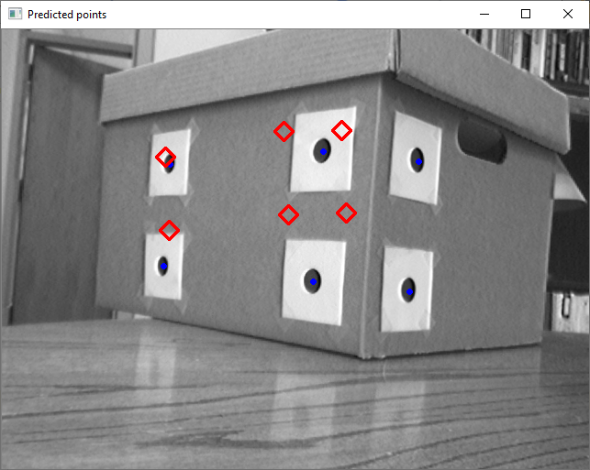
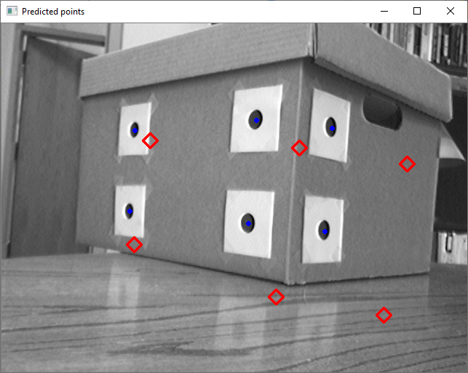
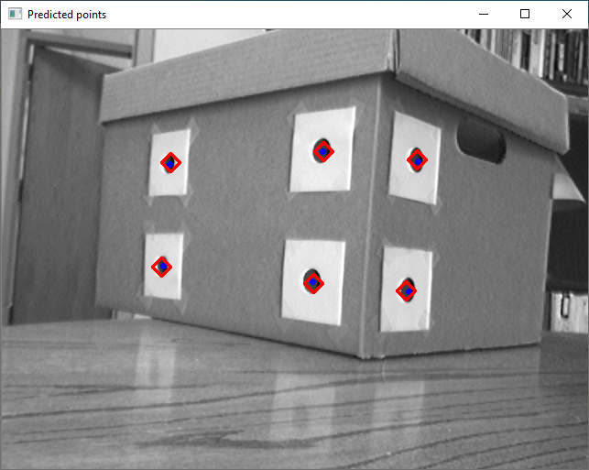
Demo
Iteration 0
Iteration 1
Iteration 0
Current pose: [ 1.5 -1. 0. 0. 0. 30. ]
Residual error: 173.2920150660433
Iteration 1
Current pose: [ 1.59092035 -0.72018267 0.1393846 1.45827025 4.7399085 12.29978598]
Residual error: 230.07343482554063
:
Iteration 7
Current pose: [ 1.54806303 -0.83227637 0.09711501 0.93423646 2.98373111 18.32860692]
Residual error: 5.166249390202682
Iteration 7

Slide 27
Overlaying Graphical Model
As a check, overlay a graphical model onto the image
If you don’t have a model, you can display the model’s coordinate axes
# Draw coordinate axes onto the image. Scale the length of the axes # according to the size of the model, so that the axes are visible. W = np.amax(P_M,axis=1) - np.amin(P_M,axis=1) # Size of model in X,Y,Z L = np.linalg.norm(W) # Length of the diagonal of the bounding box d = L/5 # This will be the length of the coordinate axes u0 = fProject(x, np.array([0,0,0,1]), K) # Project the origin uX = fProject(x, np.array([d,0,0,1]), K) # Project a point one unit from the origin along the X axis uY = fProject(x, np.array([0,d,0,1]), K) # Project a point one unit from the origin along the Y axis uZ = fProject(x, np.array([0,0,d,1]), K) # Project a point one unit from the origin along the Z axis # Draw a line from the origin to each of these three points, in red, green, and blue cv2.line(bgr_img, tuple(np.int32(u0)), tuple(np.int32(uX)), color=(0, 0, 255), thickness=3) cv2.line(bgr_img, tuple(np.int32(u0)), tuple(np.int32(uY)), color=(0, 255, 0), thickness=3) cv2.line(bgr_img, tuple(np.int32(u0)), tuple(np.int32(uZ)), color=(255, 0, 0), thickness=3) # Finally, print the pose onto the image using “putText”.

Slide 28
More images
Find the pose of the box in the other two images
img2_rect.tif
img3_rect.tif

Slide 29
Helpful OpenCV function: “solvePnP”*
Does what our iterative least squares code does
Inputs:
An array containing 3D object points, size (N,3)
An array containing corresponding 2D image points, size (N,2)
Intrinsic camera parameter matrix K, and distortion coefficients
Outputs:
rvec: Rotation vector (axis of rotation, multiplied by angle)
tvec: Translation vector
A boolean flag indicating if pose was found
*“PnP” stands for “Perspective n-Point”
isPoseFound, rvec, tvec = cv2.solvePnP(
objectPoints=P_M, # Numpy array, size (N,3)
imagePoints=pts, # Numpy array, size (N,2)
cameraMatrix=K, distCoeffs=None)

Slide 30
Helpful OpenCV function: “projectPoints”
Does what our “fProject()” function does
Inputs:
An array containing 3D object points, size (N,3)
Rotation vector (axis of rotation, multiplied by angle)
Translation vector
Intrinsic camera parameters and distortion coefficients
Outputs:
An array of 2D image points, size (N,2)
The Jacobian matrix (if you want it)
pImg, J = cv2.projectPoints(
objectPoints=P, # Numpy array, size (N,3)
rvec=rvec, tvec=tvec,
cameraMatrix=K, distCoeffs=None)

Slide 31
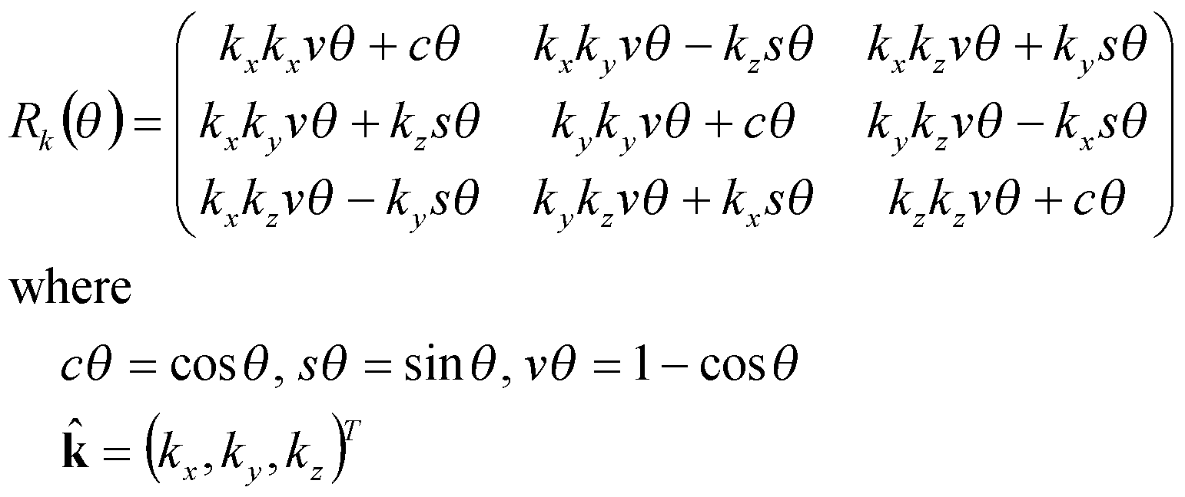
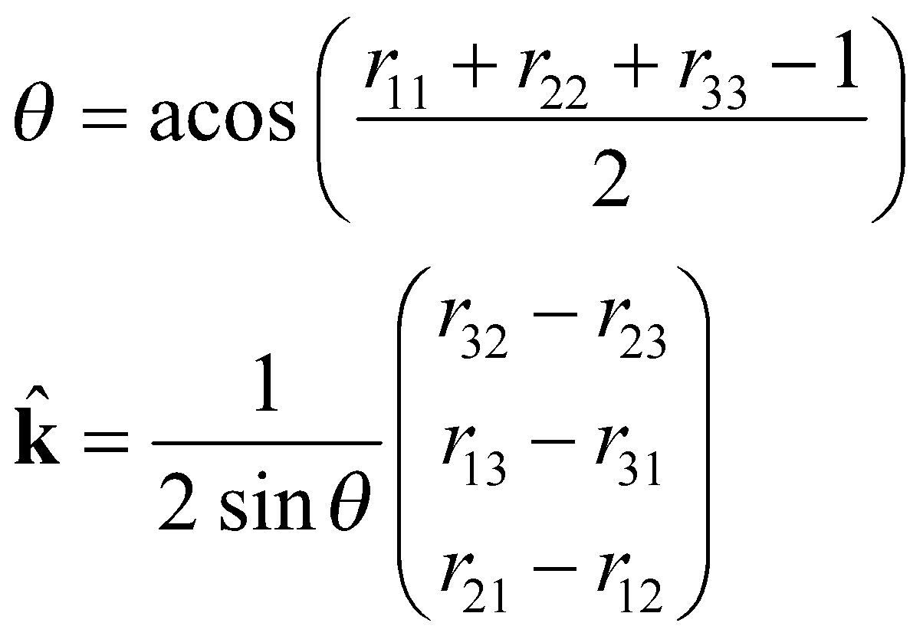
Rotation vector representation
k
A general rotation can be expressed as a rotation θ about an axis k
The product of the unit vector k and angle θ , ω = θ k = (ω_{x}, ω_{y}, ω_{z}) is a minimal representation for a 3D rotation
θ
{B}
{A}
Note that (-k,-θ) is also a solution
31

Slide 32
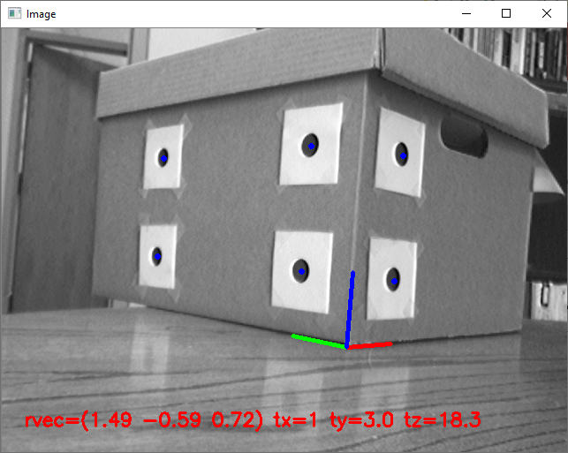
Same example – using OpenCV’s functions
isPoseFound, rvec, tvec = cv2.solvePnP( objectPoints=P_M, # Numpy array, size (N,3) imagePoints=pts, # Numpy array, size (N,2) cameraMatrix=K, distCoeffs=None) # Draw coordinate axes onto the image. Scale the length of the axes # according to the size of the model, so that the axes are visible. W = np.amax(P_M,axis=0) - np.amin(P_M,axis=0) # Size of model in X,Y,Z L = np.linalg.norm(W) # Length of the diagonal of the bounding box d = L/5 # This will be the length of the coordinate axes pAxes = np.float32([ [0, 0, 0], # origin [d, 0, 0], # x axis [0, d, 0], # y axis [0, 0, d] # z axis ]) pImg, J = cv2.projectPoints( objectPoints=pAxes, # Numpy array, size (N,3) rvec=rvec, tvec=tvec, cameraMatrix=K, distCoeffs=None) pImg = pImg.reshape(-1, 2) # reshape from size (N,1,2) to (N,2) cv2.line(bgr_img, tuple(np.int32(pImg[0])), tuple(np.int32(pImg[1])), (0, 0, 255), 3) # x cv2.line(bgr_img, tuple(np.int32(pImg[0])), tuple(np.int32(pImg[2])), (0, 255, 0), 3) # y cv2.line(bgr_img, tuple(np.int32(pImg[0])), tuple(np.int32(pImg[3])), (255, 0, 0), 3) # z cv2.imshow("Image", bgr_img)

